Slide 1
Atomic Transaction Implimentation
Lecture-18

Slide 2
Introduction
If different process executing a transaction, updates the objects it uses (file, database, records, etc.,), then transactions will not be atomic and the changes will not vanish if the transaction aborts.
Furthermore, the results of running multiple transactions will not be serializable either.
Clearly, some implimentation methods are required.
Two methods are commonly used. These are:
i. Private workspace.
ii. Writeahead log.

Slide 3
Private Workspace
When a process starts a transaction, it is given a “private workspace” containing all the files to which it has access.
Until the transaction either commits or aborts, all of its reads and writes goes to its private workspace.
The problem with this technique is that the cost of copying everything to a private workspace is prohibitive, but various optimizations makes it feasible.
The first optimization is based on the realization that when a process reads a file but does not modifies it, there is no need for a private copy.
Consequently, when a process starts a transaction, it is sufficient to create a private workspace which is initially empty except for a pointer back to it’s parent workspace.
When the transaction is at the top level, the parent’s workspace is the real file system.
When the process opens the file for reading, the back pointers are followed until the file is located in the parent’s workspace.

Slide 4
Cont..
When a file is opened for writing, it can be located in the same way as for reading, except that it is now copied to the private workspace of the transaction.
However, a second optimization removes most of the coping.
Instead of copying the entire file, only the file’s index is copied into the private workspace.
The index is the block of data associated with each file telling where its disks blocks are.
Using the private index, the file can be read in the usual way, since the disk address it contains, are for the original disk blocks.
However, when a file block is first modified, a copy of the block is made and the address of the copy is inserted into the index, as shown in the figure in the next slide.
The blocks can then be updated without affecting the original.
Appended blocks are handled this way too.
The new blocks are called as shadow blocks.

Slide 5
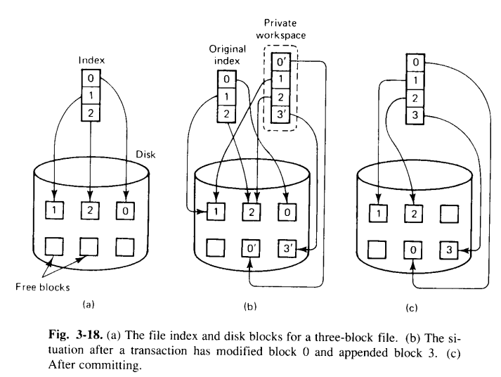
Cont..

